Slide 1
COFFEE-ML Project
Name: Omer Sela ID: 316539535 Name: Ahigad Genish ID: 316228022

Slide 2
Introduction
Final project: Software Development: Café recommendation system for coffee enthusiasts.
Project Objective: Develop a recommendation system for coffee shops.
The project will involve the creation of a software system capable of analyzing photos of coffee cups from Google Maps to identify "quality" cafes using a deep learning model.
We chose several parameters that represent good coffee('crema', 'presentation', 'type of cup', 'cappuccino', 'espresso', 'black', 'served_way’).
The purpose of the model is to receive an image of a cup of coffee and return a vector of binary values which constitute a choice of all the parameters that represent good coffee.
The model will receive only coffee photos after a YOLOV8 Object detection which decide which photos that collect from Coffee Shop on Google Maps are coffee.
Considering the result the model will return, we can understand whether the coffee in the photo is expected to be tasty.

Slide 3
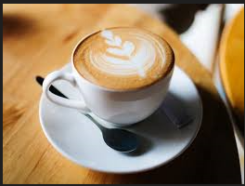
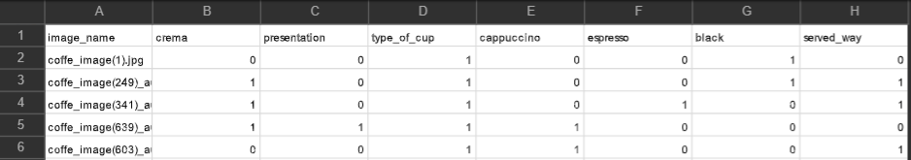
Introduction
Coffee coaster
We are now in the phase of model training.
We collected into a CSV file 900 images that we labeled according to the following binary parameters:
'crema', 'presentation', 'type of cup', 'cappuccino', 'espresso', 'black’, 'served_way’.
Each parameter decide if the coffee consist that information.
For example, the following photo (Cappuccino with crema and pretty presentation, a clay cup and served with coffee coaster tagged as : [1,1,1,1,0,0,0,1]
In contrast, a takeaway black coffee tagged as: [0,0,0,0,0,1,0]
Example of the CSV file:

Slide 4
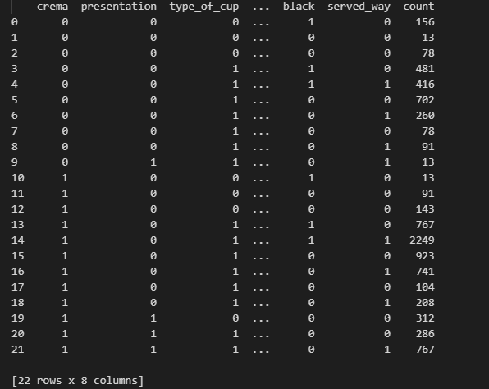
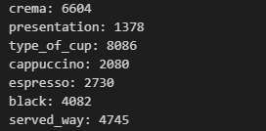
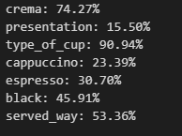
Statistics

Slide 5
What do we want to discuss?
We want to discuss the continuation of the model training.
we will ask for advice to improve the learning process of a model, so it meets the needs of our project.

Slide 6
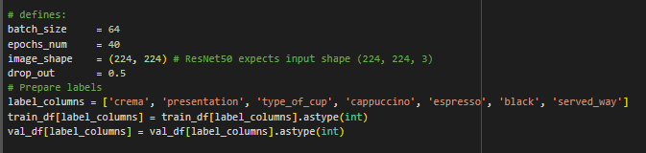
Current Status/Snapshot
We tagged alone 900 photos regarding to the following parameters.
After augmentation, we reached 8000 photos of different types of coffee cups.
We ran the VGG16 model as follows:
Defines model parameters:

Slide 7
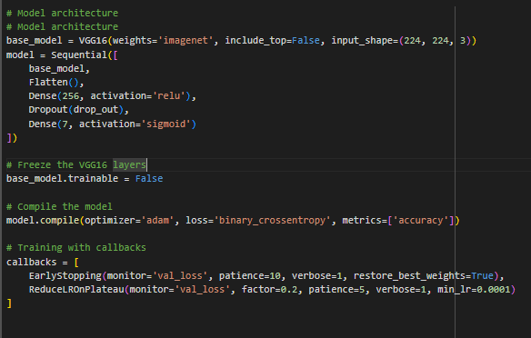
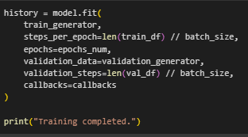
Current Status/Snapshot
Model architecture:
Train the model:

Slide 8
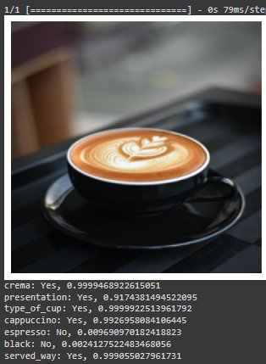
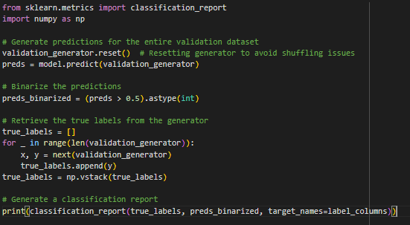
Current Status\ Snapshot
Example to one prediction:
Hard decision:

Slide 9
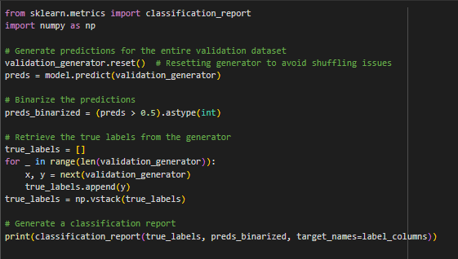
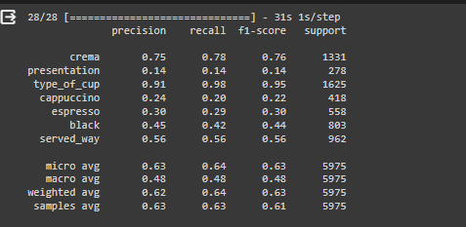
Results

Slide 10
Results
It is important to note that we tried to run with the ResNet50 model and the results were less good.
In contrast, when we ran a CNN model (developed from scratch by TensorFlow) the results were better than the VGG but not a significant improvement.

Slide 11
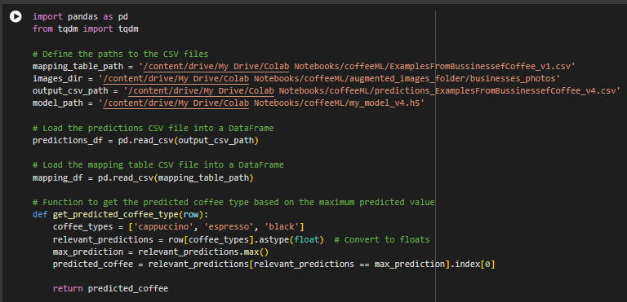
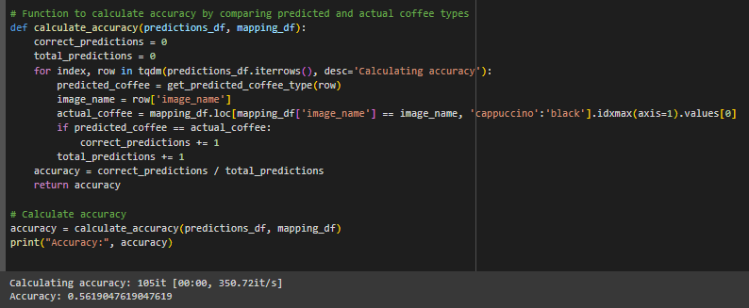
Results
Later we tagged another 100 photos from coffee shops on Google Maps and tested the model on the photos as follows:
For the type of coffee we take the maximum predicted value between cappuccino, espresso and black.

Slide 12
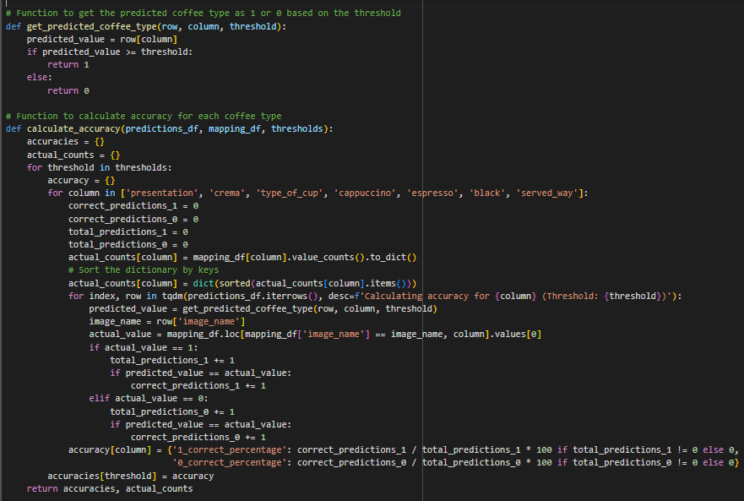
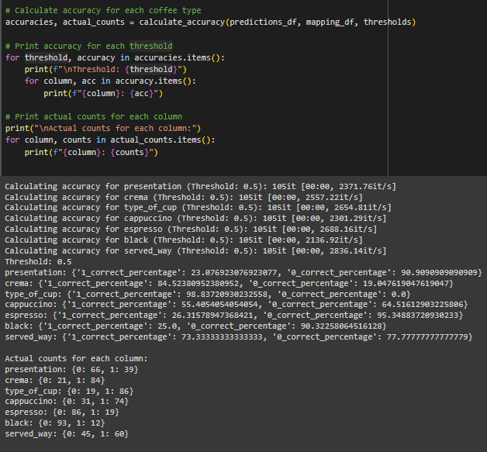
Results
For other parameters we chose a threshold to predict the value 0.5

Slide 13
What is the next step?
- Should we need to replace the VGG with new model? We already tried the ResNet50.
- Do we need to add more data and tag?
(considering the limited amount of time left to finish the model).
- Do we need to train a separate model for each parameter?

